Slide 1
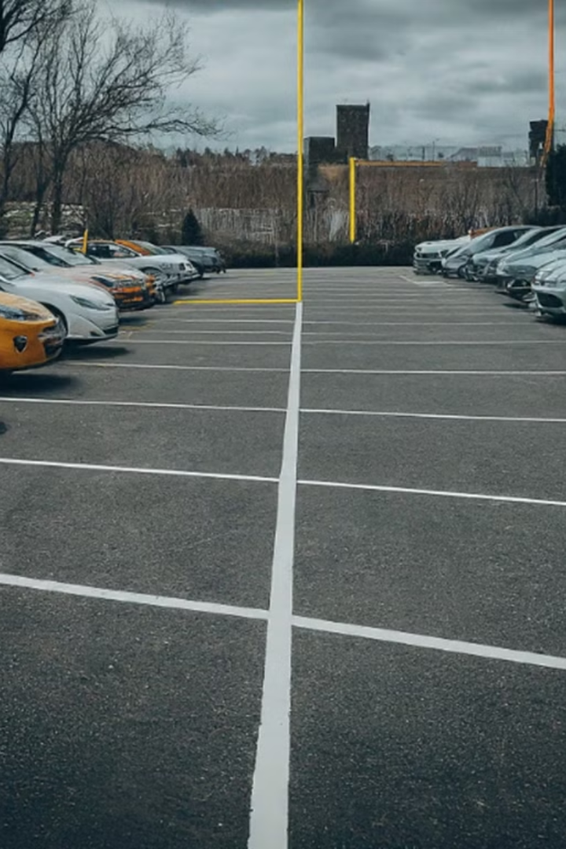
PARKING SPACE IDENTIFIER
MUNAGALA CHANDRA VAMSI REDDY (RA2211026010161)
JAMI JASWANTH (RA2211026010173)
PALAMETI REDDY LAKSHMI MANOJ (RA2211026010179)

Slide 2
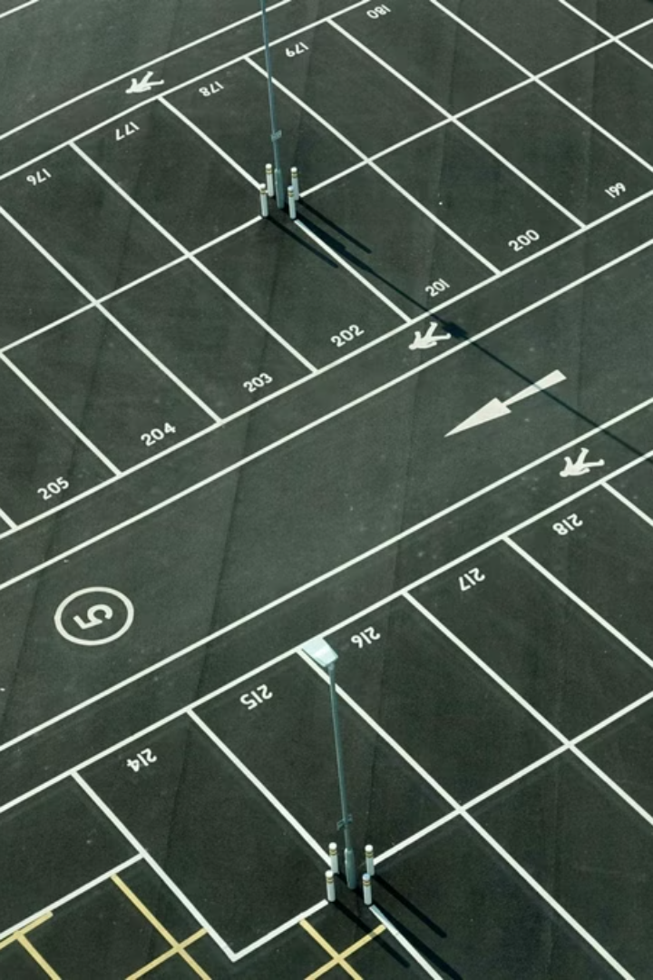
INTRODUCTION
In urban areas around the world, parking management presents a significant challenge, with congested parking lots and limited availability of spaces causing frustration and inefficiency. To address this issue, there is a growing interest in implementing smart parking solutions leveraging digital image processing techniques. This project aims to develop a Parking Space Counter system utilizing advanced image processing algorithms to monitor parking occupancy in real-time.

Slide 3
Background
1
Image Acquisition
2
Image Preprocessing
3
Object Detection
The project will focus on acquiring high-quality images of parking areas using strategically placed cameras.
Techniques such as noise reduction, color correction, and perspective transformation will be applied to the acquired images.
Advanced object detection algorithms will be used to identify vehicles in the parking area.
4
Object Tracking
5
Parking Space Detection
Tracking algorithms will be employed to monitor the movement and occupancy of vehicles in the parking spaces.
The system will detect and delineate individual parking spaces within the acquired images.

Slide 4
Motivation
Optimization of Parking Resources
Enhanced User Experience
Smart City Initiatives
Finding parking spaces can be a stressful and time-consuming experience for drivers, especially in busy urban areas. By providing drivers with real-time information on parking space availability, the project aims to enhance the user experience, reducing search times, minimizing frustration, and improving overall satisfaction with urban mobility.
The project aligns with broader smart city initiatives aimed at leveraging technology to improve urban infrastructure and services. By developing an intelligent parking management system, the project contributes to the creation of smarter, more sustainable cities, where efficient parking solutions play a crucial role in enhancing the quality of life for residents and visitors.
Many parking facilities, including garages, lots, and street parking, suffer from underutilization or overutilization of parking spaces. This inefficiency results in wasted space, revenue loss for parking operators, and frustration for drivers. By accurately monitoring parking space occupancy, the project seeks to optimize the utilization of parking resources, maximizing efficiency and revenue generation.

Slide 5
Motivation
Environmental and Economic Benefits
Inefficient parking management contributes to increased pollution and greenhouse gas emissions through prolonged vehicle idling and circling in search of parking. By reducing search times and congestion, the project has the potential to decrease fuel consumption, lower emissions, and mitigate environmental impact. Additionally, optimizing parking resources can lead to economic benefits for cities, businesses, and individuals through increased revenue and productivity.
Advancements in Digital Image Processing
Recent advancements in digital image processing technologies, including object detection, tracking, and machine learning algorithms, present new opportunities for developing innovative parking management solutions. By leveraging these technologies, the project aims to create a sophisticated parking space counter capable of accurately monitoring parking space occupancy in real-time.

Slide 6

Proposed Methodology
1
Project Planning and Requirement Analysis
The project will begin with a thorough planning phase to define the system requirements, identify key stakeholders, and establish project goals and milestones.
2
Data Collection and Preparation
Acquiring suitable datasets of parking area images will be a crucial step, including the use of publicly available datasets, custom data collection, and synthetic data generation.
3
Parking Space Detection and Occupancy Determination
The core of the system will involve algorithms for detecting individual parking spaces and monitoring their occupancy status in real-time.

Slide 7
Datasets
—
PKLot dataset: The dataset consists of images of parking spaces along with corresponding bounding box masks. In order to facilitate object detection and localization, every parking space in the images is annotated with a bounding box mask.
Dataset structure
images - contains of original images of parkings
boxes - includes bounding box labeling for the original images
annotations.xml - contains coordinates of the bounding boxes and labels, created for the original photo
Labels for the parking space:
free_parking_space - corresponds to free parking spaces, the box is blue
not_free_parking_space - corresponds to occupied parking spaces, the box is red
partially_free_parking_space - corresponds to partially free parking spaces, the box is yellow

Slide 8
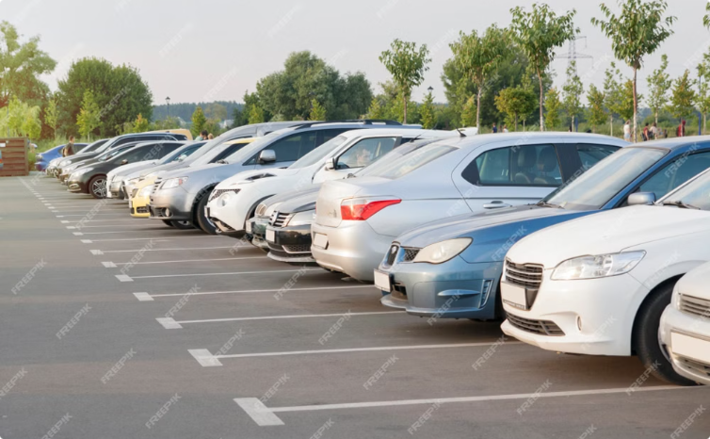
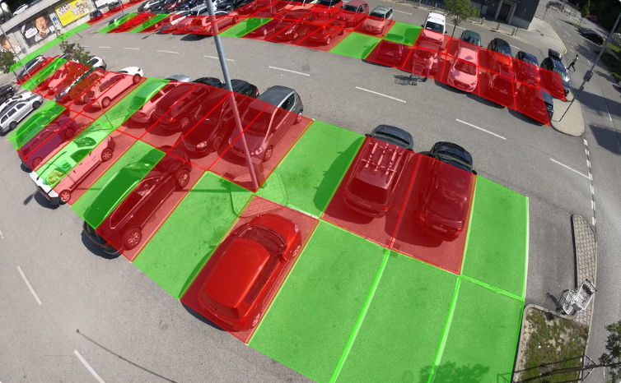
Results and Analysis
INPUT IMAGE
OUTPUT IMAGE
The system will process input images captured from parking area cameras to detect and track vehicles and determine parking space occupancy.
The output of the system will be an annotated image that highlights the detected parking spaces and their occupancy status, providing real-time information to drivers and parking operators.

Slide 9
Conclusion
In conclusion, the Parking Space Counter project represents a significant step forward in addressing the challenges associated with urban parking management through the application of digital image processing techniques. By developing an intelligent system capable of accurately monitoring parking space occupancy in real-time, the project aims to improve urban mobility, optimize parking resource utilization, and enhance the overall user experience for drivers and parking operators.
Throughout the project lifecycle, various methodologies, algorithms, and technologies were leveraged to design, implement, and evaluate the parking space counter system. Key components such as object detection, tracking, and occupancy determination were carefully developed and integrated to create a cohesive solution capable of processing live video streams from parking area cameras.
The results and analysis conducted as part of the project demonstrated the effectiveness and performance of the parking space counter system across different scenarios and environments. Quantitative metrics, qualitative assessments, real-world testing, and statistical analysis provided valuable insights into the system's capabilities and limitations, guiding iterative improvements and optimizations.
As technology continues to evolve and urbanization intensifies, the insights and methodologies developed through the Parking Space Counter project lay the foundation for future innovations in parking management and urban mobility. By embracing digital image processing techniques and addressing ethical considerations, the project paves the way for smarter, more sustainable urban environments where efficient parking solutions play a pivotal role in enhancing quality of life for residents and visitors alike.

Slide 10

References
Academic Publications
Open-Source Resources
The project references several academic publications, including journal articles and conference papers, that provide the theoretical foundation and practical insights for the parking space counter system.
The project also leverages open-source documentation and tutorials, such as those provided by OpenCV and PyImageSearch, to guide the implementation of the image processing and computer vision algorithms.

